Slide 1
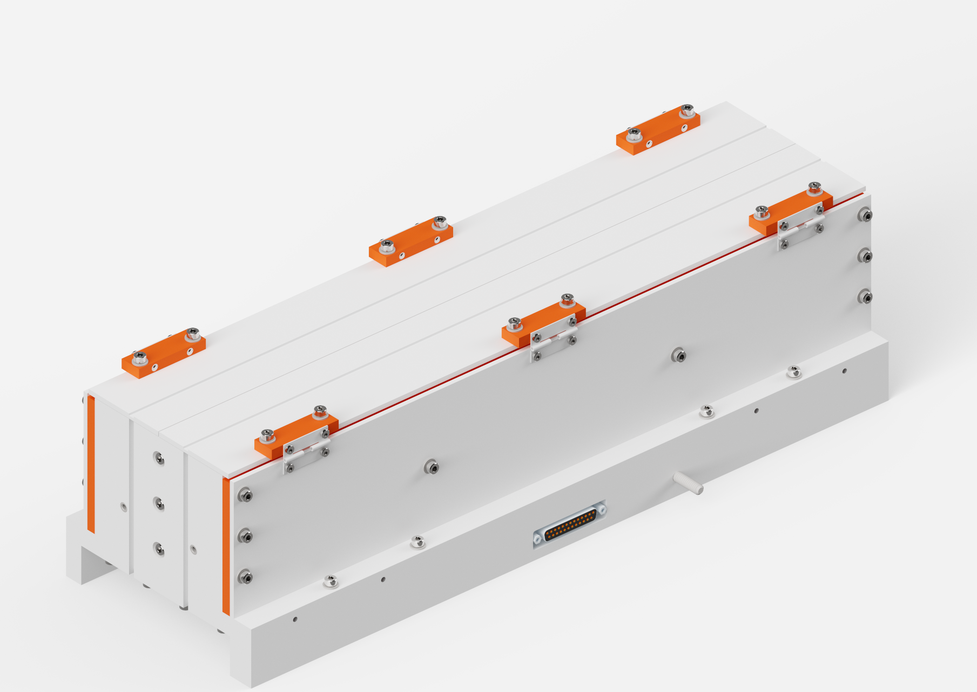
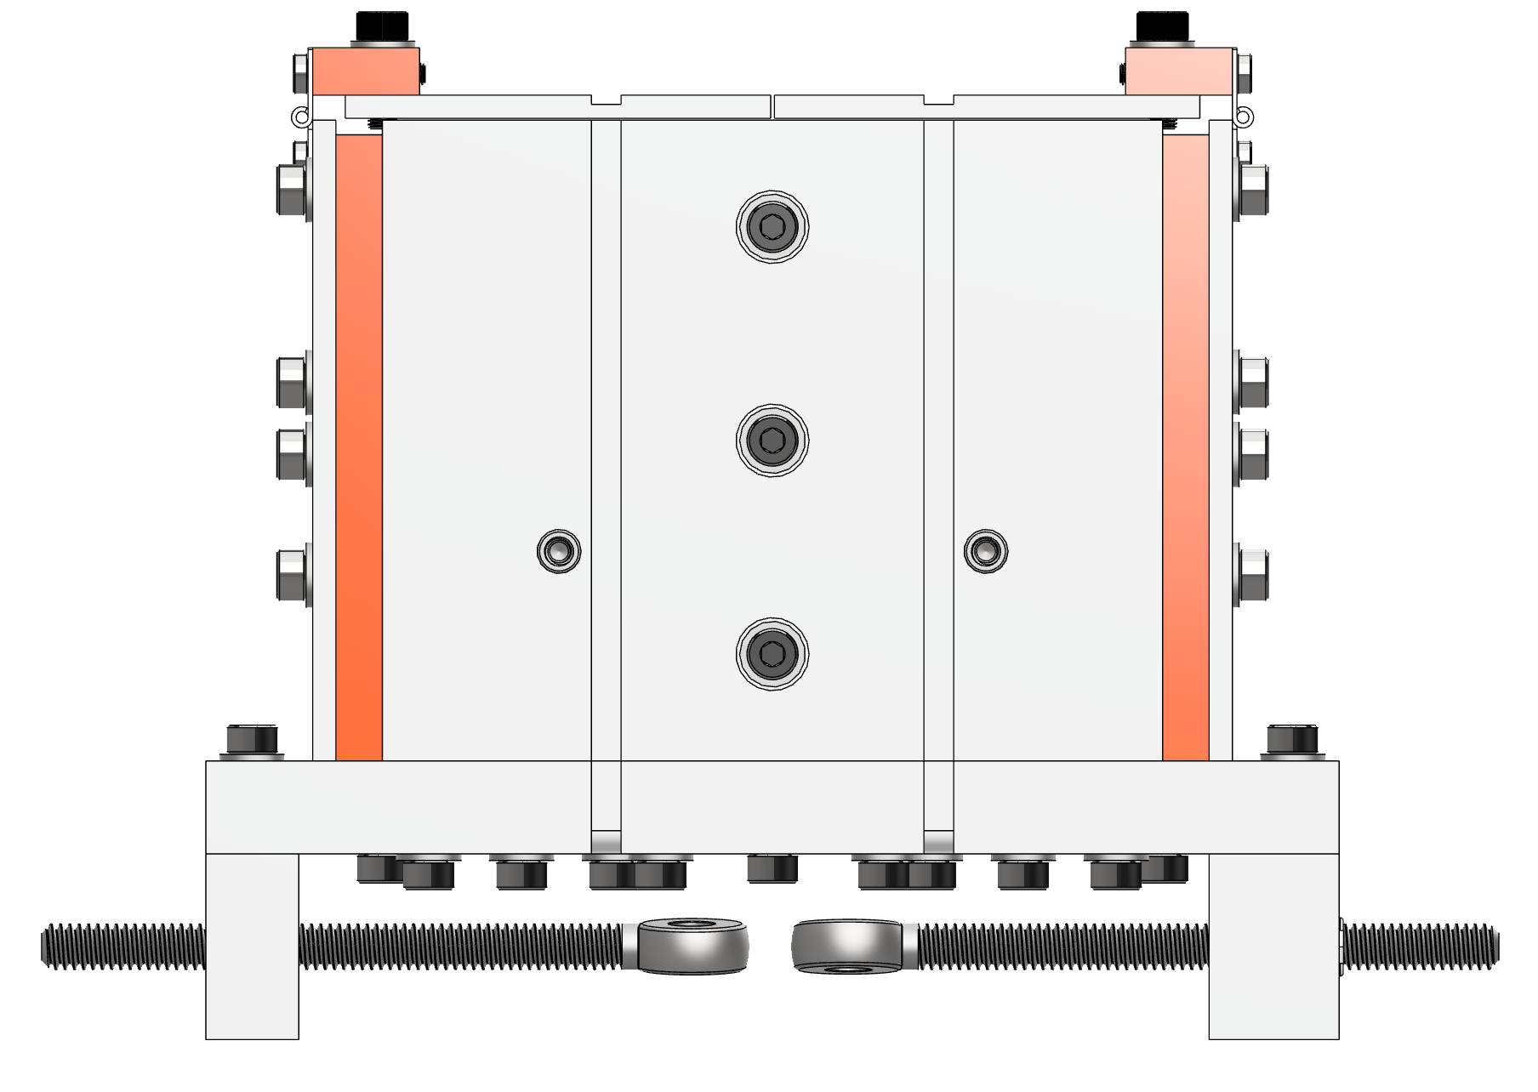
Isometric
Side
140.546mm
Y
459.606mm
185.661mm
X
Z
Length (X): 459.606mm
Height (Y): 140.546mm
Width (Z): 154.940mm (185.661mm with Tensioning Bolts)
Closed

Slide 2
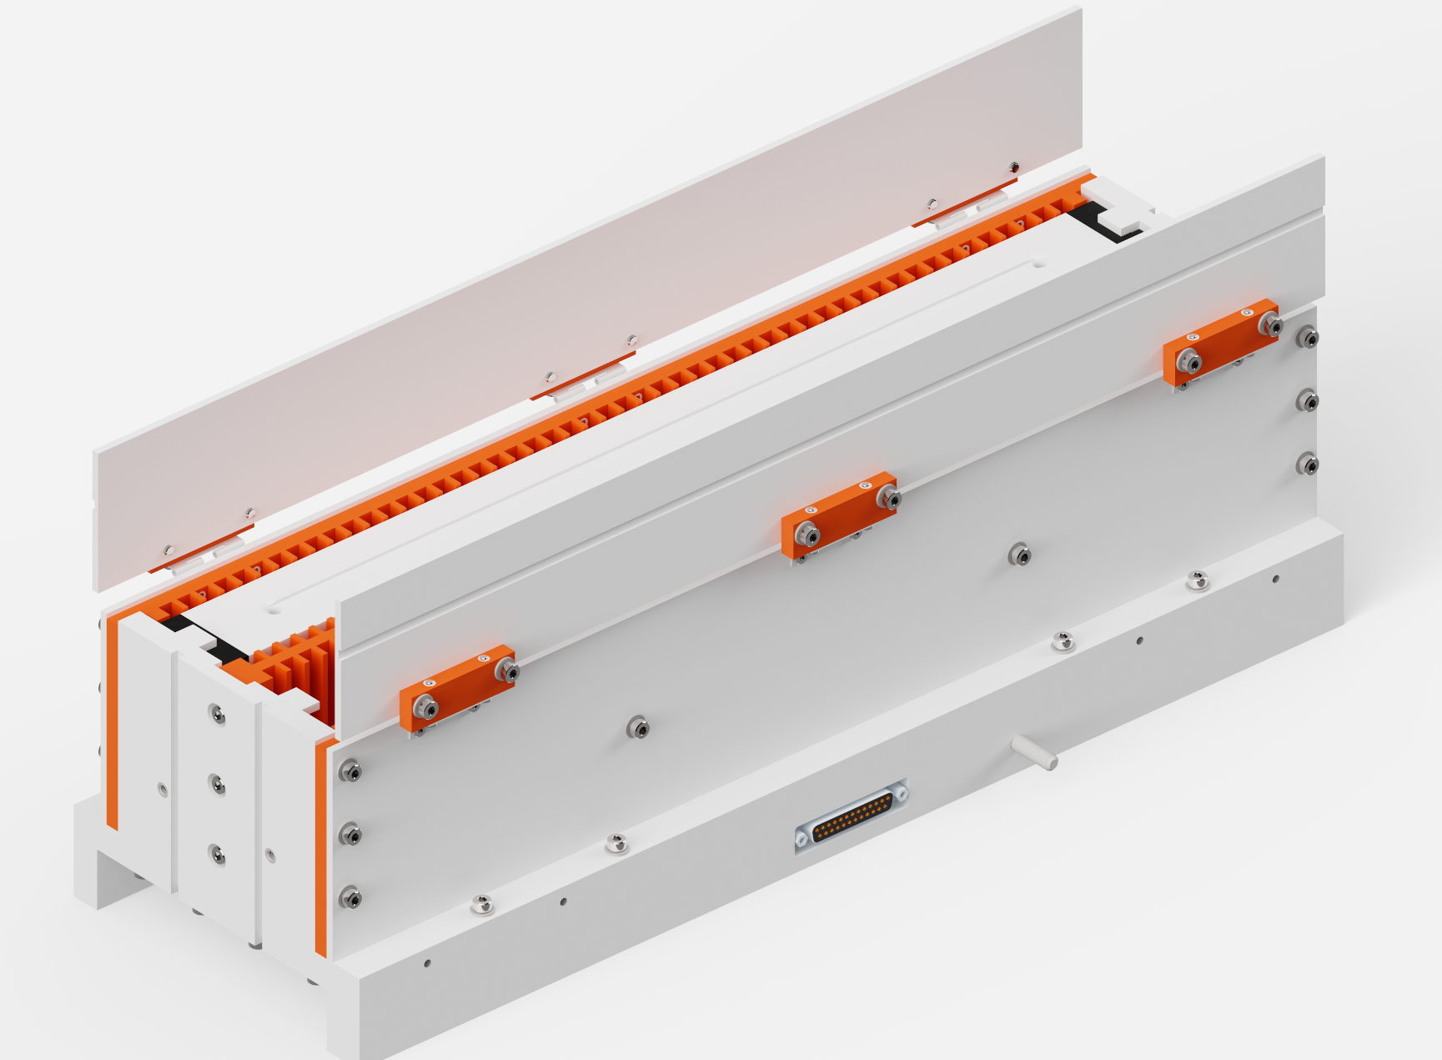
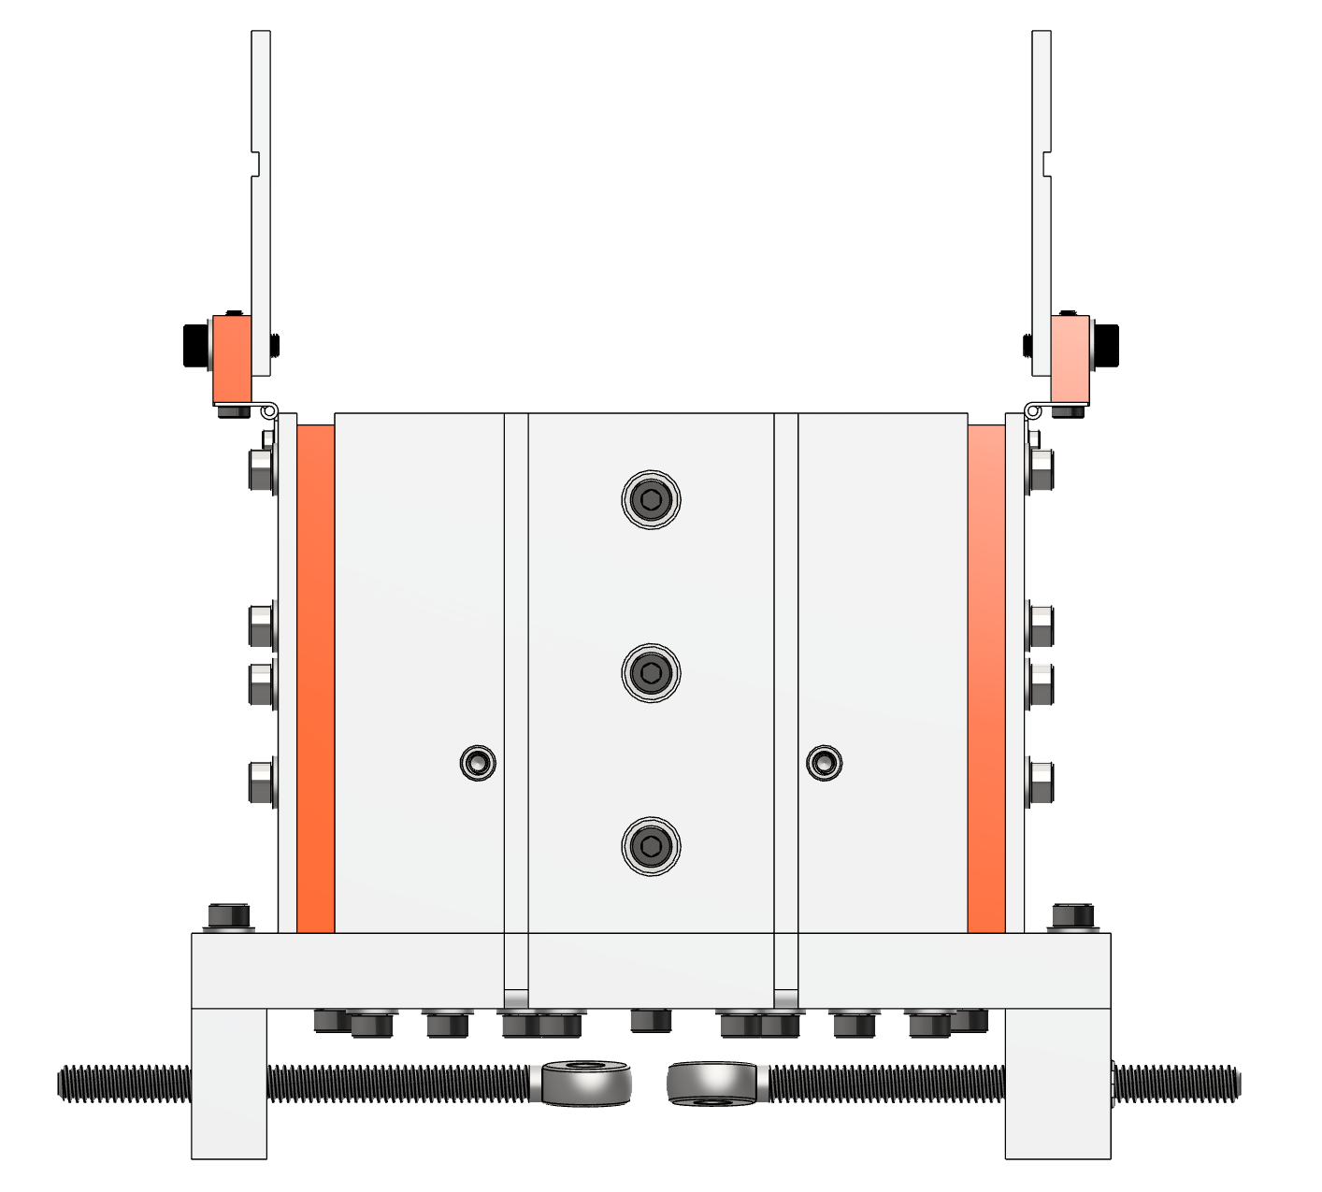
Isometric
Side
190.176mm
Y
459.606mm
185.661mm
X
Z
Length (X): 459.606mm
Height (Y): 190.176mm
Width (Z): 157.488mm (185.661mm with Tensioning Bolts)
Partial Open

Slide 3
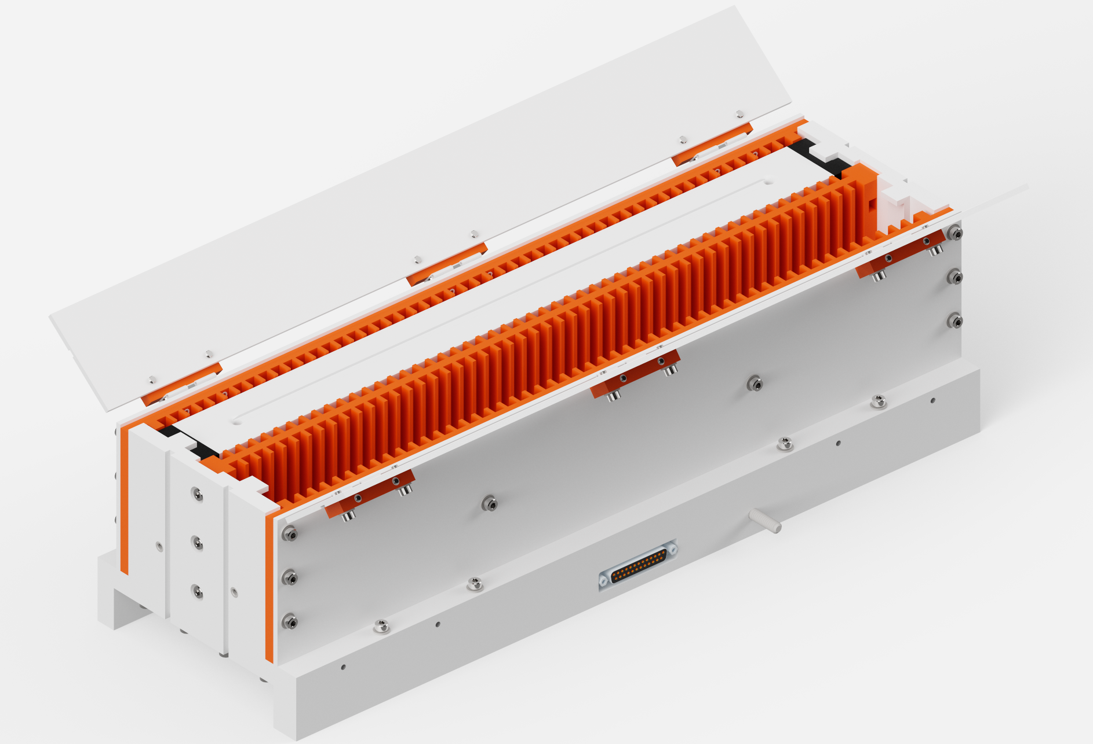
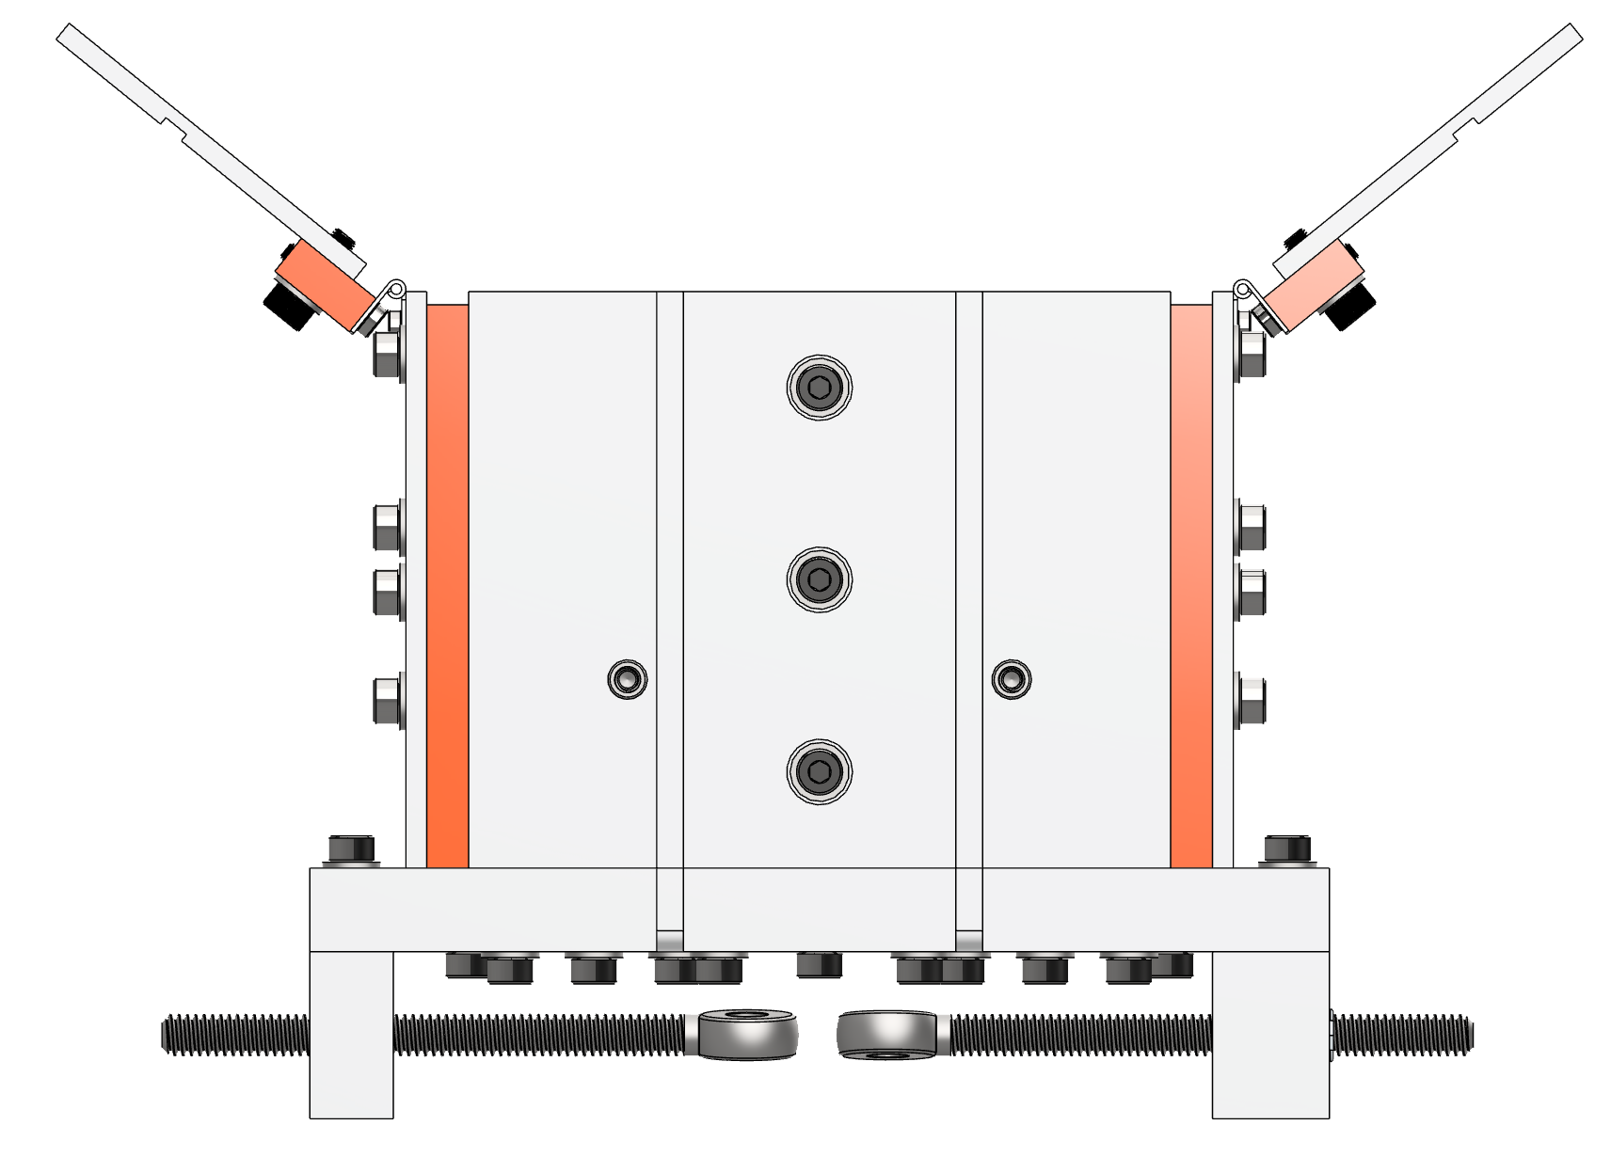
Isometric
Side
166.527mm
Y
459.606mm
232.051mm
X
Z
Length (X): 459.606mm
Height (Y): 166.527mm
Width (Z): 232.051mm
Open Full

